Slide 1

Final Year Project Presentation - Enhanced Intrusion Detection System (IDS)
Lee Jun Lam TP055697 APD3F2302CS(CYB)

Slide 2
Problem Statement
Traditional Intrusion Detection System has high false negatives and false positives.
Traditional Intrusion Detection System unable to detect unknown vulnerabilities without updates.
Traditional Intrusion Detection Systems have become inadequate in the face of today's ever-evolving threat landscape.

Slide 3

Aims and Objective
Aim
To conduct a comprehensive examination of issues regarding Intrusion Detection Systems (IDS) and the realm of Machine Learning. The reason behind is to create and implement an Enhanced IDS embedded with Machine Learning, advancing the precision and effectiveness of cyber-attack identification through supervised learning to enhance accuracy and operational efficiency with utilizing the Python programming language.

Slide 4
Aims and objectives
To conduct a detailed analysis of the current Intrusion Detection Systems (IDS) and identify the limitations and challenges of current IDS.
To implement machine learning algorithms to improve the accuracy of intrusion detection.
To test and evaluate the performance of the developed system by using datasets.

Slide 5

Target user
Educational Institutions
Individuals
Business Organizations, Including Small and Medium Enterprises (SMEs)

Slide 6
Functionalities / Deliverables
Core
Dataset Uploading and Exploration
Dataset Cleaning
Dataset Visualization
Dataset Manipulation and Transformation
Dataset Training
Dashboard Simulator
Enhance
Password Hashing
File Upload Handling
Special
Graphical User Interface

Slide 7
Domain Research
Integrating Machine Learning with IDS
How to integrate Machine Learning with IDS
Implement Enhanced IDS with Machine Learning through CICDdos2019 Dataset

Slide 8
Integrating Machine Learning with IDS (machine learning pipelines)
What do I have What do I need
What can I get
Problem Definition
Data collection
Feature extraction
Flattening,Labeling
Data preparation
Normalisation by data type
Dimensionality reduction
Algorithm Selection
Train and Test
Performance Evaluation
Visualisation
Parameter tuning
Model Validation
“Objective” in “objective function”
image processing: segmentation
Exploratory Data Analysis
May have special data preparation requirements
Selection of metric – “objective function”
Repeat Train and Test
Repeat Train and Test

Slide 9
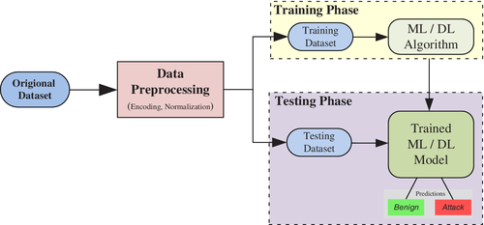
How to integrate Machine Learning with IDS

Slide 10
Implement Enhanced IDS with Machine Learning through CICDdos2019 Dataset
1. Eliminating Socket Features: According to (Laurens D’hooge et al., 2022), exclude socket-related attributes such as source and destination IP addresses, source and destination ports, timestamps, and flow IDs. These attributes tend to vary across different networks, making it essential to train the model solely on packet characteristics. Additionally, the presence of identical IP addresses for both intruders and legitimate users can lead to overfitting if socket information is incorporated into the machine learning model.
2. Data Cleansing: The original dataset may contain a considerable number of missing (NaN) and infinite values, which are deemed irrelevant. Therefore, it is recommended to systematically eliminate these values from the dataset (Gulati & Raheja, 2021).
3. Label Encoding: The model can be designed for binary classification, distinguishing between normal and malicious network traffic. Alternatively, the model can be designed for multi label classification besides from distinguishing between normal and malicious network traffic, but also classify type of malicious network traffic (Jiang et al., 2020).

Slide 11
Similar system (Part 1)
Features | Suricata | Snort | Zeek
Detection methods | Signature-based, anomaly-based, and policy-driven | Signature-based and anomaly-based | Signature-based and anomaly-based
Network speed support | Real-time intrusion detection and prevention, monitoring network security | Analyzes real-time network traffic | Traffic logging and analysis
Customizability | Compatible with Snort's data structure, allows implementation of Snort policies, examine TLS/SSL certificates, HTTP requests, and DNS transactions | Can create own rules or download from Snort community, but creating rules can be complicated | Tailored to a variety of network security use cases, but gaining proficiency in Bro DSL may require some programming experience and effort
Rule set support | Can use Snort’s rulesets | Can create own rules or download from Snort community | N/A
Operating systems supported | Windows, Linux, Unix | Windows, Linux, Unix | Unix, Linux, Mac OS
Real-time analysis | Yes | Yes | No
Limitations | Prone to false positives, can be system and network resource intensive | Lack of GUI (although community-developed add-ons exist), complexity of creating rules leading to false positives, packet processing can be slow | Some programming experience is required. Gaining proficiency in Bro DSL can take some effort.

Slide 12
Similar system (Part 2)
Features | OSSEC | Sagan | Splunk
Detection methods | Rule-based approach | Anomaly and signature-based detection methods | Anomaly-based HIDS
Operating systems supported | Linux, Windows, macOS | Unix, Linux, macOS | Linux, Windows
Real-time analysis | Yes | Yes | Yes
Customizability | Highly customizable | Highly customizable | Customizable with higher cost options
Rule set support | Custom rules or pre-defined community rules | Custom rules | Custom rules
Limitations | Reliance on agent-based deployment | Steep learning curve for new users | Higher cost, use of custom Search Processing Language (SPL) for queries

Slide 13
Technical research
System Develop Methodology Chosen:
Rapid Application Development (RAD)
Programming Language Chosen:
Python
HTML
CSS
Develop Tools Chosen:
IDE Selection- Visual Studio Code
Flask
Pandas
Numpy
Scikit-Learn (sklearn)
Seaborn and Matplotlib
Imbalanced-Learn (imblearn)

Slide 14
Primary Research
Questionnaire
Interview

Slide 15
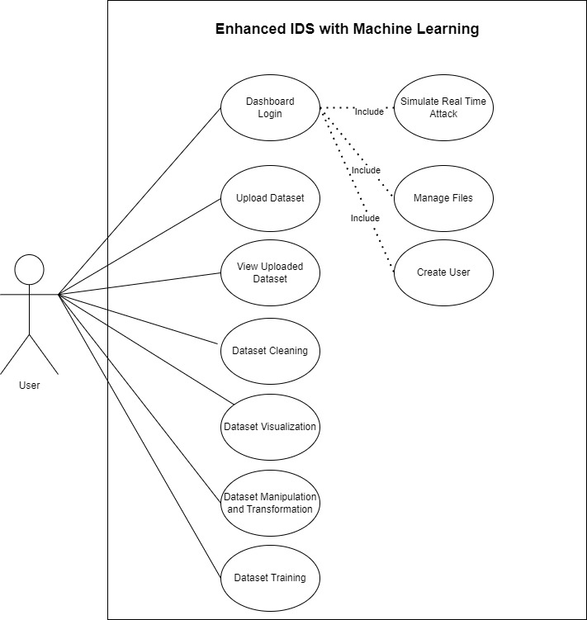
Use case diagram

Slide 16
Use case Specification - Upload Dataset
Function Name | Upload Dataset
Description | Require user to upload at least one or more csv files into the system
Actor | User
Assumption | Users have access to the system and upload valid data file(s)
Default Workflow | The actor is required to select one or more csv files from their local storage. Once the actor selects the files, the system proceeds to validate the files' format and content to ensure it matches the require file format (csv). If the validation is successful, the system stores the dataset into the system storage folder (upload). The actor is then notifying that upload datasets successful, which become readily available for exploration, analysis, and transformation.

Slide 17
Use case Specification - View Uploaded Dataset
Function Name | View Uploaded Dataset
Description | Provides insights into dataset characteristics, including dimensions, column names, and data types. Users can preview the first 10 rows to verify data accuracy.
Actor | User
Assumption | Users have successfully uploaded datasets into the system.
Default Workflow | The actors are presented with an informative overview of the datasets they have previously uploaded into the system. The system retrieves and displays essential details, including dataset dimensions, column names and preview the first 10 rows of the dataset, facilitating a straightforward data assessment.

Slide 18
Use case Specification - Dataset Cleaning
Function Name | Dataset Cleaning
Description | Require user to select at least one or more uploaded csv files to conduct dataset cleaning to remove unwanted features
Actor | User
Assumption | Users have successfully uploaded datasets with matching column names into the system.
Default Workflow | The actor initiates by selecting one or more CSV files from the system. Subsequently, the system combines the chosen datasets, computes statistics such as missing and infinity values, and identifies duplicate rows. The data cleaning involving the removal of rows with missing or infinity values alongside with duplicate rows and the elimination of socket features columns and columns that displaying zero. The user is then prompted to designate a name for the cleaned dataset.

Slide 19
Use case Specification - Dataset Visualization
Function Name | Dataset Visualization
Description | Allows users to visualize both the uploaded and cleaned datasets to assess label quantity disparities
Actor | User
Assumption | Users have successfully uploaded datasets (to visualize uploaded datasets) and perform dataset cleaning (to visualize cleaned datasets)
Default Workflow | Upon selecting the "Dataset Visualization" feature, the system renders visual representations of the uploaded and cleaned datasets. Users can identify any imbalances in label quantities and make informed decisions for the next step

Slide 20
Use case Specification - Dataset Manipulation
Function Name | Dataset Manipulation
Description | Requires user to choose one out of three distinct manipulation options: "Balanced Dataset," "Combine Label," and "Drop Label." These options address varying label quantity disparities and inaccuracies in attack categorization during dataset training.
Actor | User
Assumption | User has successfully performed dataset cleaning
Default Workflow | The actor is presented with the three options: "Balanced Dataset," "Combine Label," and "Drop Label." They can choose the most suitable option based on their dataset's characteristics. "Balanced Dataset" implements Random Oversampling, "Drop Label" trims significant variations, and "Combine Label" addresses misclassification issues.

Slide 21
Use case Specification - Dataset Training
Function Name | Dataset Training
Description | Empowers users to create and train machine learning models using the cleaned datasets. Users can choose from a diverse range of algorithms
Actor | User
Assumption | User has successfully performed dataset cleaning and data manipulation (optional)
Default Workflow | Upon selecting "Dataset Training," the actor accesses an environment for model creation and training by selecting cleaned dataset and machine learning algorithm. This feature transforms the system into a versatile machine learning hub, facilitating various analytical tasks with precision and efficiency.

Slide 22
Use case Specification - Dashboard Login
Function Name | Dashboard Login
Description | Involves the process of securely authenticating users to access the system's dashboard, ensuring that only authorized individuals can utilize the system's features.
Actor | User
Assumption | Users have registered accounts and credentials to the dashboard features.
Default Workflow | The actors are prompted to provide their username and password. The system then verifies the user's credentials against the stored account information. If the provided credentials are valid, the system grants the user access to the dashboard. However, if the credentials are invalid, the system displays an error message and returns the actors to the login page.

Slide 23
Use case Specification - Simulate Real Time Attack (Dashboard Simulator)
Function Name | Simulate Real Time Attack (Dashboard Simulator)
Description | A risk-free environment to explore and simulate model behavior, test various scenarios, and evaluate performance metrics.
Actor | User
Assumption | User has performed dataset cleaning progress, dataset training progress and download trained model
Default Workflow | The actors are required to upload clean csv files (with the same column names that are used to train the model). The system validates the file, loads it into a Data Frame, and conducts real-time attack simulation using a pre-trained model. The results are displayed for user review, and any errors are promptly addressed with corresponding error messages.

Slide 24
Use case Specification - Create User
Function Name | Create User
Description | Allows individuals to create accounts with unique usernames and secure passwords for dashboard login.
Actor | User
Assumption | Users have logged in successfully to the system's dashboard.
Default Workflow | The actor enters the new user's details, including a unique username and a secure password. The system validates the provided information, and if it's valid, the system proceeds to create the new user account. The system then notifies the user of their account creation.

Slide 25
Use case Specification - Manage Files
Function Name | Manage Files
Description | Empowers users to download and remove files from their workspace within the system.
Actor | User
Assumption | Users have logged in successfully to the system's dashboard.
Default Workflow | The actors are presented with their file workspace, which displays a list of uploaded and cleaned files and options to download and remove files from their workspace within the system. The user can select files for download or removal through check box follow by select the corresponding option.

Slide 26
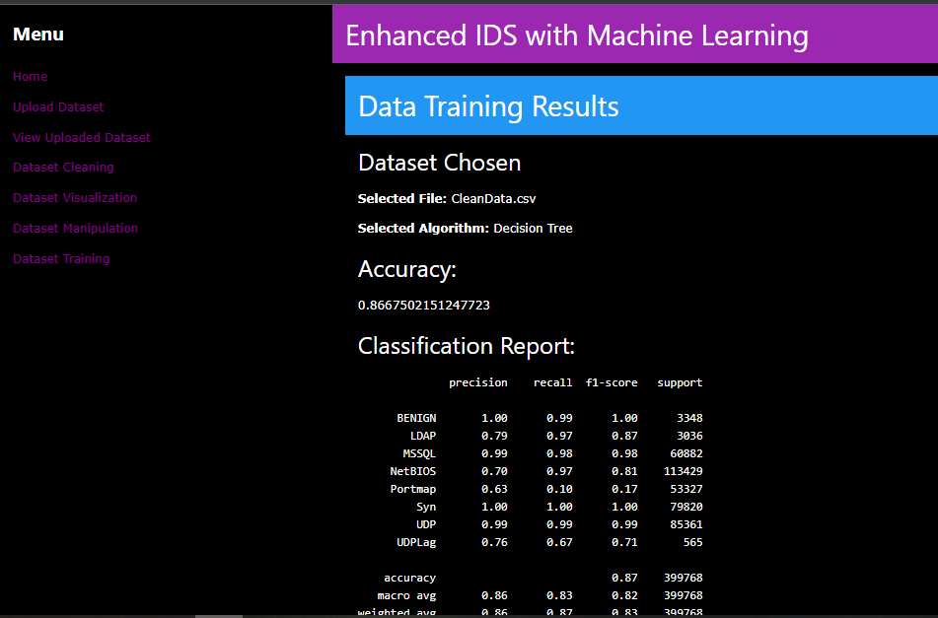
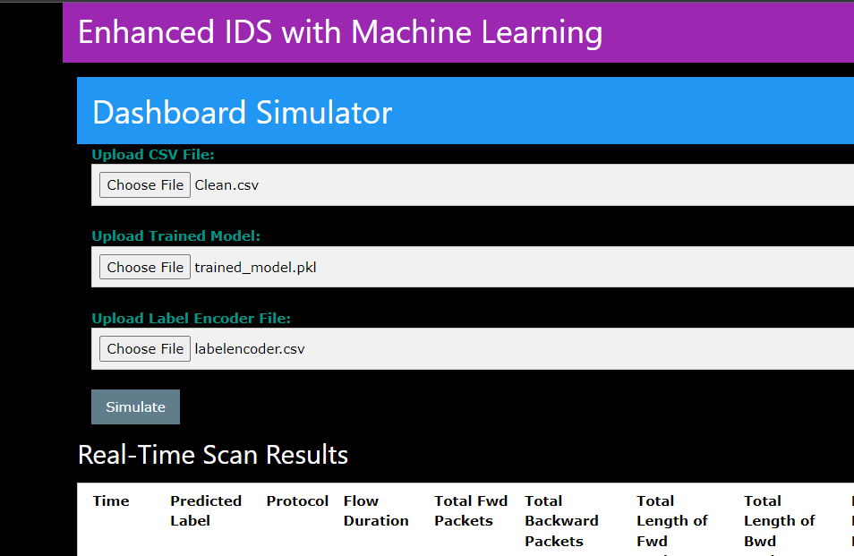
Implementation

Slide 27
Testing
Unit Testing for all pages (all pass)
UAT done for 4 users
User interface needs further improvement
Model accuracy for the malicious attack classification needs to improve
Add more additional features for the GUI system

Slide 28
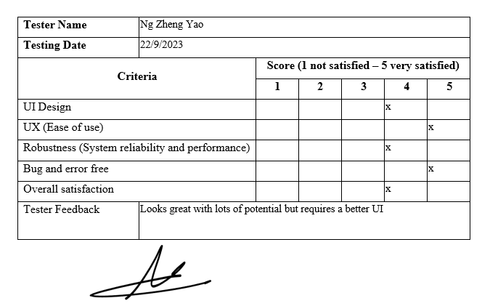
User acceptance testing (Ng Zheng Yao)

Slide 29
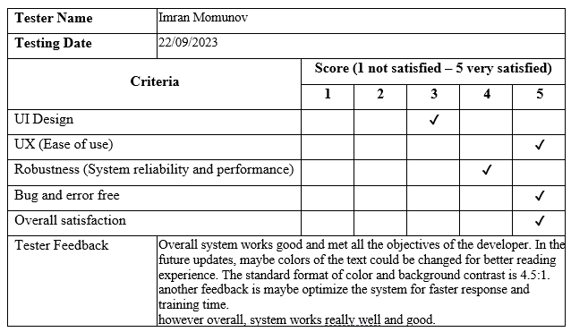
User acceptance testing (Imran Momunov)

Slide 30
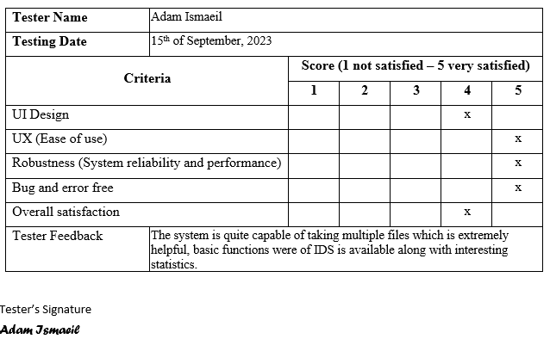
User acceptance testing (Adam ismaeil)

Slide 31
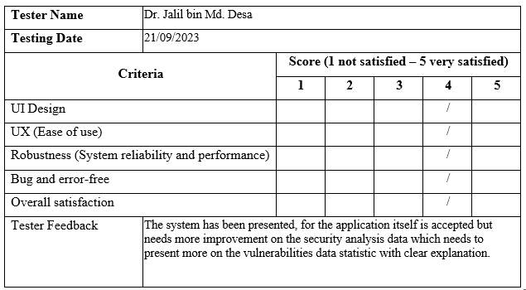
User acceptance testing (Dr Jalil bin md. desa)

Slide 32
Problem & Limitation
Imbalanced Dataset
Incorrect Malicious Type Classification
Requires Cybersecurity and Artificial Intelligence Expert for further improvement

Slide 33
Future enhancement
Ng Zheng Yao
Improve User Interface
Imran Momunov:
Improve User Interface through brighter color and text for better
Optimize the System for faster response
Adam Ismaeil:
N/A
Dr Jalil bin Md. Desa
Security analysis data need more improvement to present more on the vulnerabilities data statistic with clear explanation

Slide 34
Conclusion
Improve coding proficiency through hands-on development
Enhanced documentation abilities, facilitating project comprehension
Strengthened time management skills to meet project milestones efficiently.

Slide 35

Question & answer Session

